Slide 1
Measurement of magnetic field using Hall Probe Gaussmeter
Power engineering
UG-3rd year
2nd semester
2020-21

Slide 2
Objective
To measure magnetic field of a bar magnet using Hall Probe Gaussmeter
To draw the 2D contour plot of magnetic field using Matlab

Slide 3
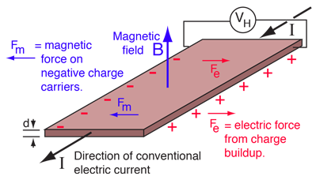
HALL EFFECT

Slide 4
HALL EFFECT
When an electric current flows through a conductor under influence of a magnetic field, the magnetic field exerts a transverse force on the moving charge carriers.
This is evident in a thin flat conductor as illustrated in the earlier slide.
The accumulation of charges at the sides of the conductors balances the influence of magnetic field, producing a measurable voltage between the two sides of the conductor.
This phenomenon of occurrence of the measurable transverse voltage is called the Hall effect after E. H. Hall who discovered it in 1879.
Hall Effect Sensors are made of a thin piece of rectangular p-type semiconductor material such as gallium arsenide (GaAs), indium antimonide (InSb) or indium arsenide (InAs) which allow a continuous current through itself.

Slide 5
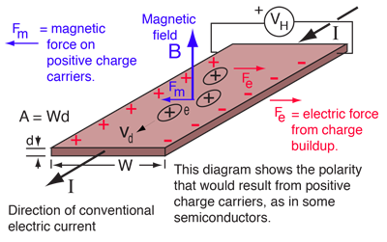
HALL VOLTAGE

Slide 6
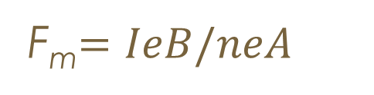


HALL VOLTAGE
The current expressed in terms of the drift velocity
Where n is the charge carrier density
Then the force on the positive charge carrier is
At equilibrium
$$I=neAvd$$
F_{m}$=IeB/neA$
F_{e}$=Fm$
or, V_{H}e/W=$\frac{IeB}{neA}$
_{Or,} V_{H}=$\frac{IB}{ned}$
_{Or,} V_{H}=K_{H}$\frac{IB}{d}$

Slide 12
Results (z=10 mm)
Sl. No. | Position along x-axis (mm) | Position along y-axis (mm) | Value of the magnetic field (Gauss)
1 | 10 | 10 | 107
2 | 10 | 20 | 280
3 | 10 | 30 | 301
4 | 10 | 40 | 298
5 | 20 | 10 | 220
6 | 20 | 20 | 288
7 | 20 | 30 | 299
8 | 20 | 40 | 298
9 | 30 | 10 | 281
10 | 30 | 20 | 293
11 | 30 | 30 | 297
12 | 30 | 40 | 290
13 | 40 | 10 | 290
14 | 40 | 20 | 293
15 | 40 | 30 | 295
16 | 40 | 40 | 296

Slide 13
Matlab code
Use the following commands to plot the contour of the magnetic field
meshgrid
contourf
grid on
colorbar

Slide 14
THANK YOU

